Slide 1
Digital Library Architecture:
A Service-Based Approach

Slide 2
Why Talk about Digital Library Architecture?
Web alone is not a digital library
Commercial packages limited
  limited flexibility
  standards issues
  network-enabled applications not DL architecture
Must position for broader DL opportunities

Slide 3
Web by itself not a DL Architecture
Documents - Files, CGI, MIME-Types
Naming - URLs
Document Servers - HTTP servers
Resource Discovery - web crawlers
Collections - web pages, ad-hoc
IP - Access Control List, passwords, ad-hoc

Slide 4
WWW Infrastructure
Evolving
Resource Description Framework (RDF)
  will allow rich metadata semantics for documents
  http://www.w3.org/RDF/
Extensible Markup Language (XML)
  will allow highly structured documents and rich linking (relationship) capabilities
  http://www.w3.org/XML/
Uniform Resource Names (URNs)
  will allow for persistent, globally unique identifiers

Slide 5
But still need Digital Library Architecture
Richer document model - digital objects
Persistent, unique naming - URNs
Well-defined digital library services
Better facilities for resource discovery
Flexible definition of collections
Management of distributed content & services
Rights management for intellectual property

Slide 6





Digital Library Interoperability
Cornell
Digital Library
Nordic
Digital Library

Slide 7
Digital Library Architecture:
Key Principles
Open Architecture
  functionality partitioned into set of well-defined services
  services accessible via well-defined protocol
Modularization
  promotes interoperability
  scalable to different clientele (research library, informal web)
Federation
  enable aggregations into logical collections
Distribution
  of content (collections) and services
  of administration and management of DL

Slide 8

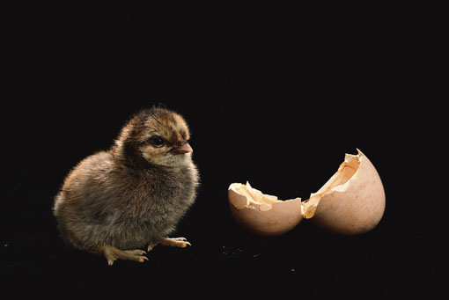
Component-Ware Digital Libraries
Collection Services
Name
Service
User
Interface
Gateway
Persistent
NAMES
Index
Services
Digital
Objects
Repository Services

Slide 9
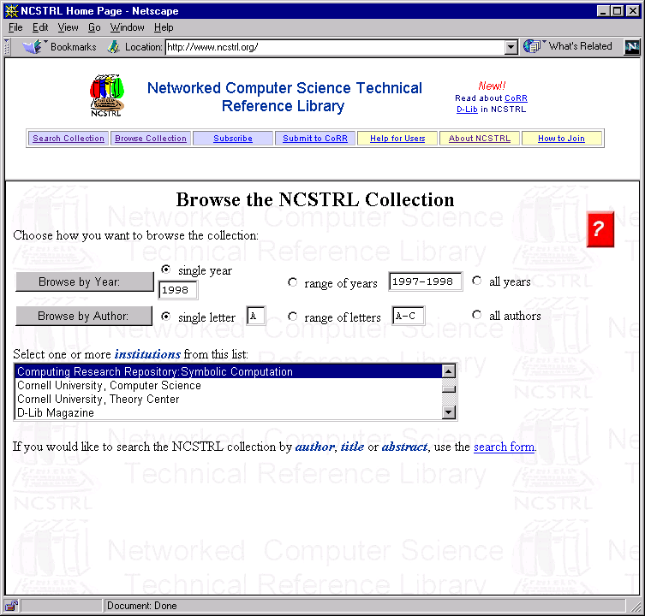
Federation
of
Collections

Slide 10
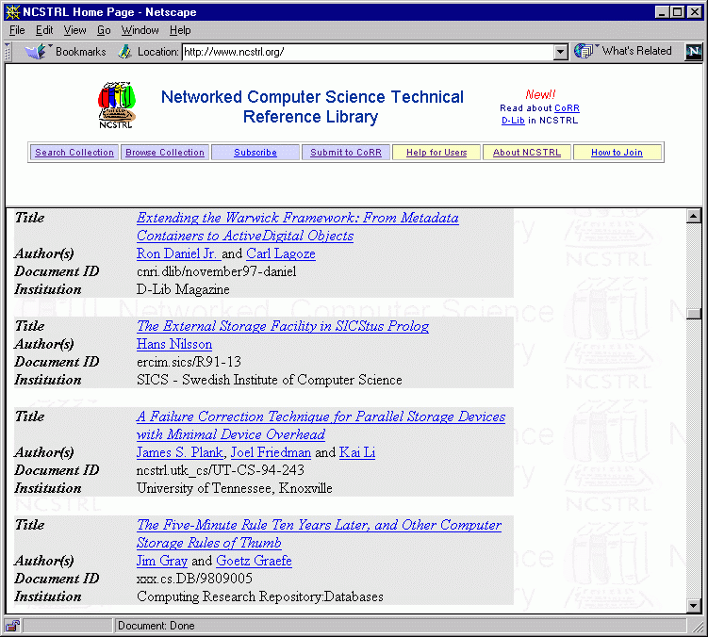
Documents in
Distributed
Repositories

Slide 11
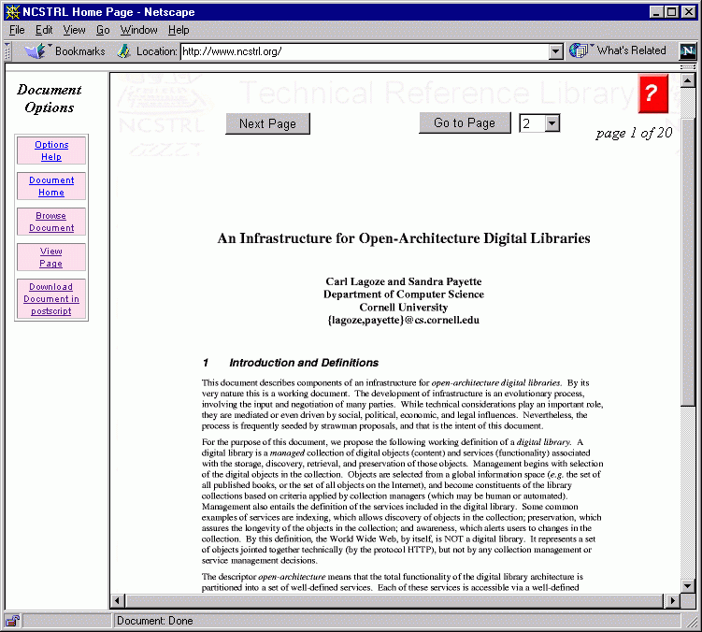
Multi-Format
Document
Model

Slide 12
Document Model
Handle (URN)
representations
decompositions
PostScript
metadata
ASCII
TIFF
underlying formats
physical
logical

Slide 13
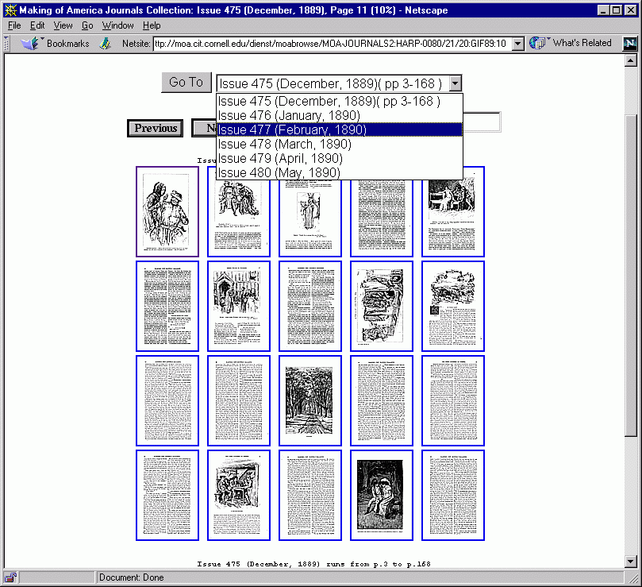

Slide 14
Document Protocol
Documents addressable through their URNs
Document service requests
  get document metadata
  get document formats
  get document in format
  get document partition (page) in format

Slide 15
Core Services
WWW
browser
Protocol
send search request
send document request
receive MIME-typed document
receive unified hit list
Dienst User
Interface
send site specific search request
receive hit list
send document request
receive MIME-typed document
Protocol
Index
Index
Index
Protocol
Repository
Repository
Repository

Slide 16
Dienst Protocol
Building Gateways to non-Conforming Sites
User
Interface
Gateway Server
Standard Servers
FTP/HTTP “Repositories”

Slide 17
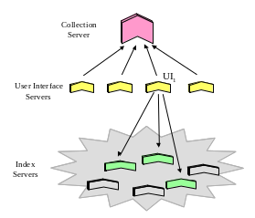
Collection Service

Slide 18
Naming Service
Documents identified by globally unique names
Names are persistent, permanent
Registered names resolve to specific location (URL)
cnri.dlib/april97-payette
Persistent
Identifier
(e.g., URN)
Naming
Authority
Item
Name
Location
(URL)
http://www.somewebserver.org/somedirectory/somefile

Slide 19



Digital Object is...
getSection
getArticle
getTrack
getLabel
getChapter
getPage
getFrame
getLength
recognizable by what it can do

Slide 20
What the client sees vs.
What the object is
Book
Content-Type
Interfaces
MARC
Mechanism
Structure

Slide 21

FEDORA DigitalObject
GetChapter
GetIndex
GetPage
Book
Disseminator
DublinCore
Disseminator
ListContentTypes
application/
MARC
DS₁
Generic
Disseminator
Book, DublinCore
application/
postscript
Get(Book.getPage(1))
DS₂

Slide 22







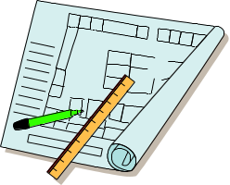
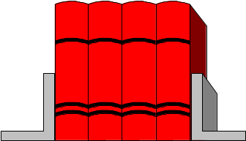

FEDORA:
Extensibility for Content Types
Simple, familiar content types
Complex, compound, dynamic content types

Slide 23
Distributed Collection Service
Definition and Access
User
Interface
Intelligent routing
based on regional conditions
Collection
Query
Router
Central
Collection
Server
Collection
Query
Router
Collection
Query
Router

